Slide 1
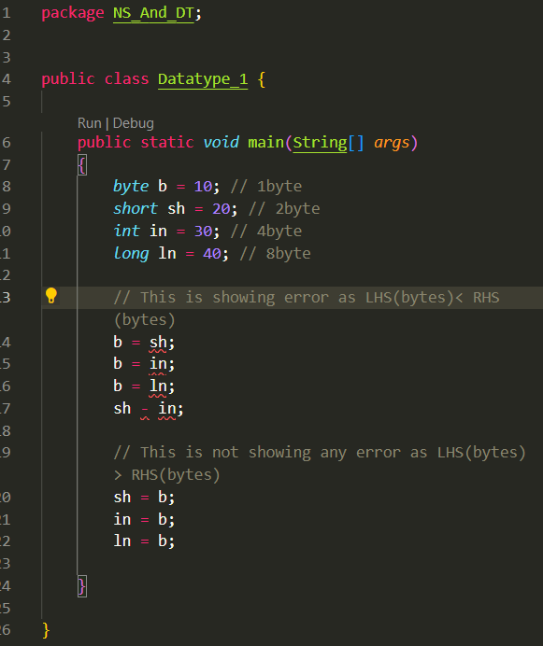
By default literal without decimal dots are integer

Slide 2
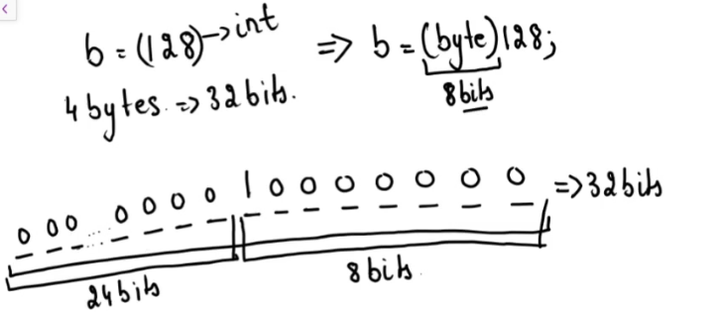
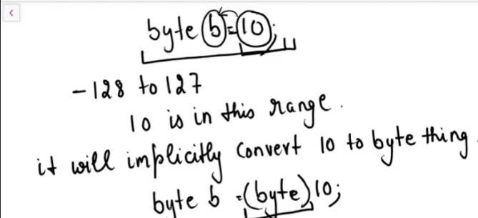
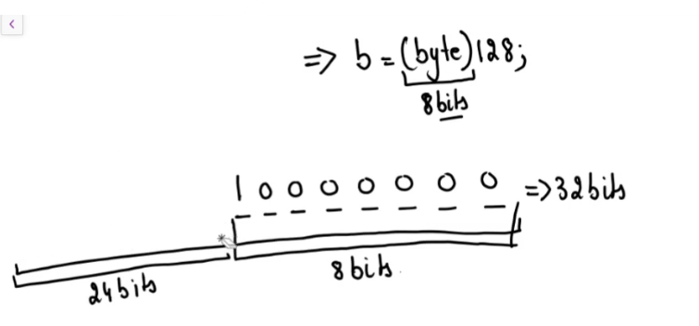
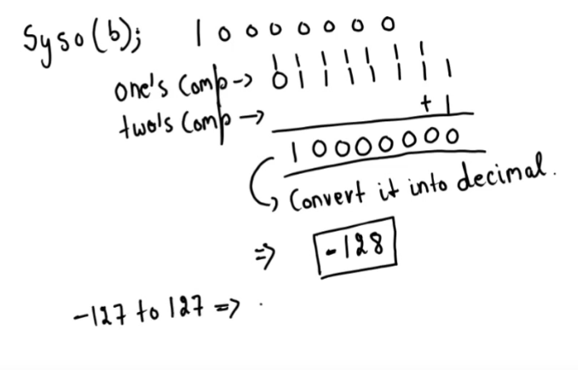
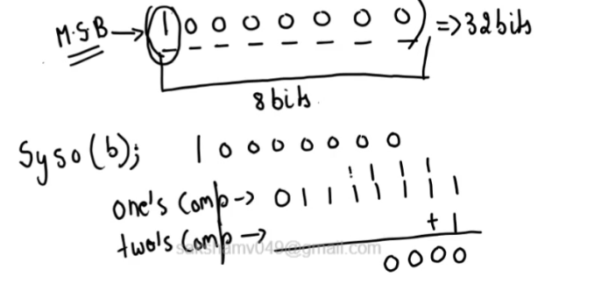
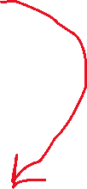

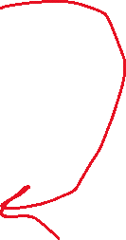
Implicit Conversion
It treats it as –ve number as MSB =1
This also tells what happens to that wasted
(-0) it gets converted to -128

Slide 3
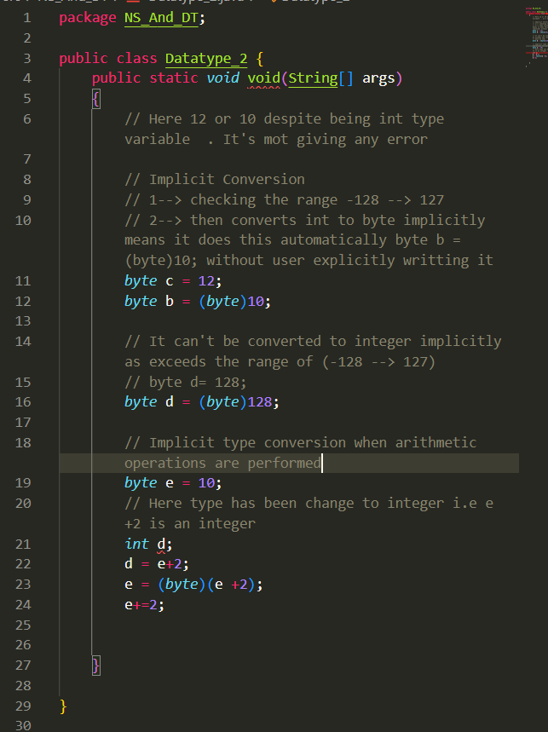

Slide 4
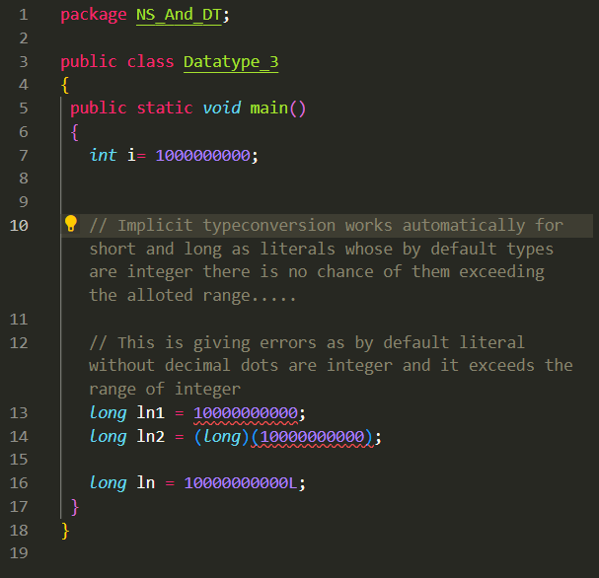

Slide 5
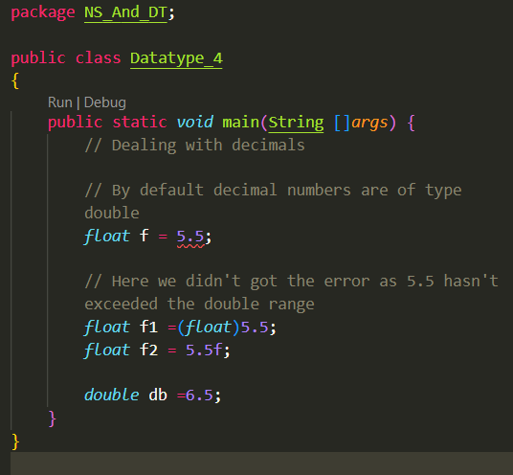

Slide 6
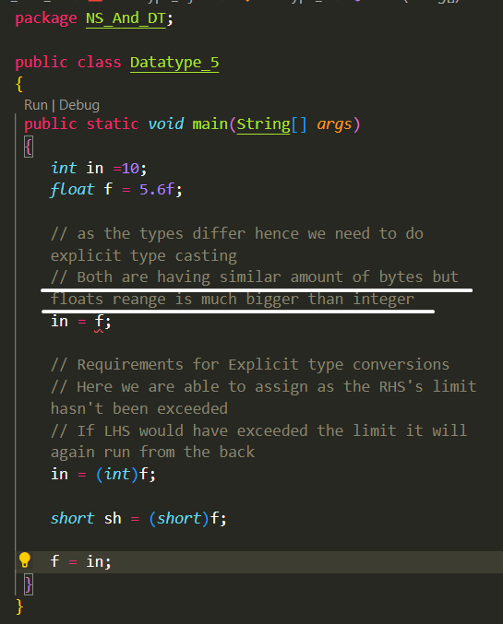

Slide 7
Default for decimal (double)
Default for integers (integer)
RHS will give error when exceeds integer/ double ranges for there respective cases
Range of float > int though having same amount of bytes
Explicit call is required when exceeds the range
Implicit call occurs when datatype having higher bytes falls in the range of LHS.

Slide 8
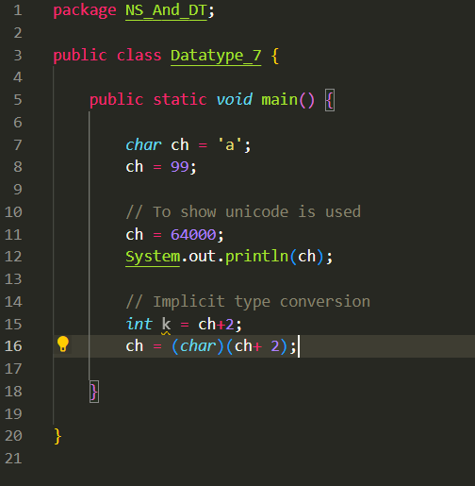

Slide 9
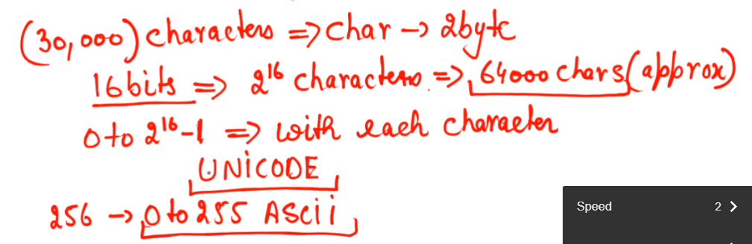
Char (2 bytes) 0 → (2^16) -1

